Slide 1
Resource location and Traffic Routing
Session 02
Course : COMP6584001 – Network and Systems Programming
Ivan Sebastian Edbert

Slide 2
Learning Objectives
At the end of this session, the student will be expected to :
Understand Internet Protocol
Understand Internet Traffic Routing
Understand Routing Protocols
Understand Name and Address Resolution

Slide 3
Outline
Internet Protocol
Traffic Routing
Routing protocols
Name and address Resolution

Slide 4
Internet protocol

Slide 5
Internet protocol
The Internet Protocol (IP) is a protocol, or set of rules, for routing and addressing packets of data so that they can travel across networks and arrive at the correct destination
Data traversing the Internet is divided into smaller pieces, called packets.
IP information is attached to each packet, and this information helps routers to send packets to the right place.
Every device or domain that connects to the Internet is assigned an IP address, and as packets are directed to the IP address attached to them, data arrives where it is needed.
Two versions of IP addresses are in public use: IPv4 and IPv6. This chapter covers both.

Slide 6
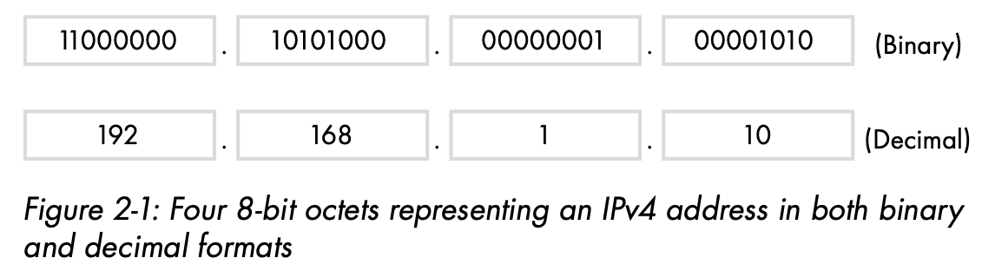
Internet protocols
IPv4 Addressing
IPv4 is the fourth version of the Internet Protocol. It was the first IP version in use on the internet’s precursor, ARPANET, in 1983, and the predominant version in use today. IPv4 addresses are 32-bit numbers arranged in four groups of 8 bits (called octets) separated by decimal points.
The total range of 32-bit numbers limits us to just over four billion possible IPv4 addresses. Figure 2-1 shows the binary and decimal representation of an IPv4 address.

Slide 7
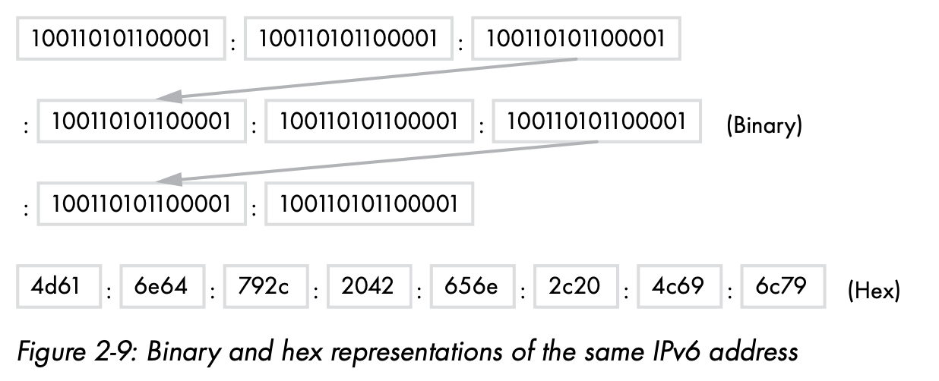
Internet protocol
Ipv6 addressing
Another solution to the IPv4 shortage is to migrate to the next generation of IP addressing, IPv6. IPv6 addresses are 128-bit numbers arranged in eight colon-separated groups of 16 bits, or hextets. There are more than 340 unde- cillion (2128) IPv6 addresses.
Writing IPv6 Addresses in binary form, IPv6 addresses are a bit ridiculous to write. In the interest of legibility and compactness, we write IPv6 addresses with lowercase hexa- decimal values instead.
A hexadecimal (hex) digit represents 4 bits, or a nibble, of an IPv6 address. For example, we’d represent the two nibbles 1111 1111 in their hexadecimal equivalent of ff. Figure 2-9 illustrates the same IPv6 address in binary and hex.

Slide 8
Internet protocol
Ipv4 vs ipv6
Address Length:
IPv4: Uses 32-bit addresses, which results in approximately 4.3 billion unique addresses.
IPv6: Uses 128-bit addresses, providing an immensely larger address space, with 2^128 (about 3.4 x 10^38) unique addresses.
Subnetting:
IPv4: Often requires subnetting due to the limited address space. Subnet masks are used to divide the address space into smaller segments.
IPv6: Subnetting is typically less complex due to the abundance of addresses available. The addressing structure allows for hierarchical addressing without the need for Network Address Translation (NAT) in most cases.
Address Notation:
IPv4: Addresses are expressed in dotted-decimal format, such as 192.168.0.1.
IPv6: Addresses are expressed in hexadecimal notation separated by colons, such as 2001:0db8:85a3:0000:0000:8a2e:0370:7334.
Security:
IPv4: Security features such as IPsec are optional.
IPv6: IPsec support is mandatory, providing a built-in framework for securing communications.
In summary, IPv6 was introduced to address the limitations of IPv4, primarily the exhaustion of address space. While IPv4 continues to be the dominant protocol, the transition to IPv6 is ongoing to accommodate the growing number of devices connected to the Internet and to overcome the challenges posed by the limited IPv4 address space.

Slide 9
Traffic Routing

Slide 10
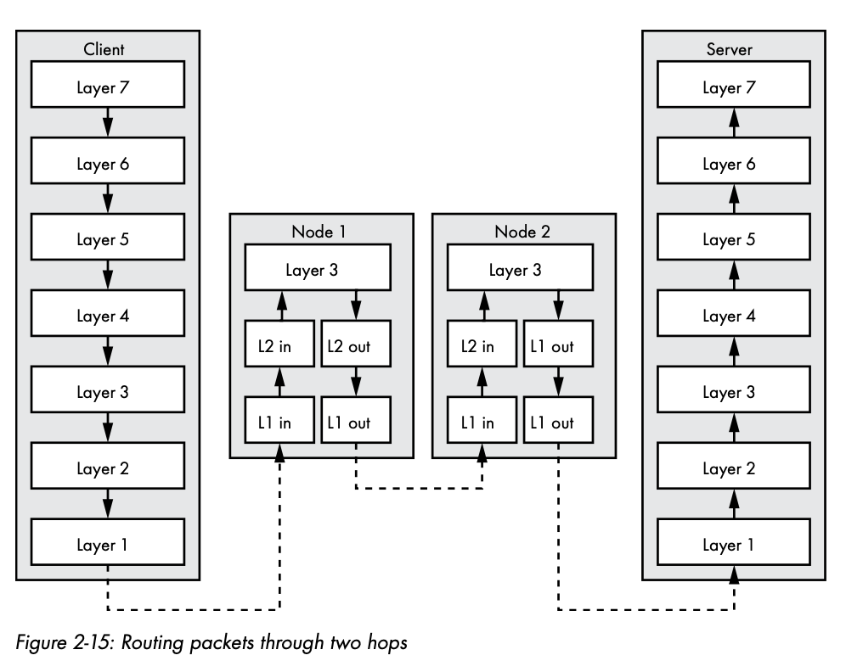
Internet Traffic routing
Internet traffic routing refers to the process of directing data packets from their source to their destination across a network of interconnected routers and switches.
Routing is a critical aspect of the Internet's infrastructure, enabling efficient and reliable communication between devices and networks. The process involves multiple steps and the use of routing protocols to determine the optimal paths for data transmission.

Slide 11
Routing protocols

Slide 12
Routing protocols
Routing protocols are sets of rules and algorithms that routers use to exchange information and make decisions about the best paths for data transmission in a computer network.
These protocols play a crucial role in determining the most efficient routes for data to travel between devices.
There are various routing protocols, and they are broadly categorized into two types: Interior Gateway Protocols (IGPs) and Exterior Gateway Protocols (EGPs).

Slide 13
Routing protocols
Interior Gateway Protocols (IGPs)
Interior Gateway Protocols (IGPs) are routing protocols used within an autonomous system (AS) to exchange routing information among routers.
An autonomous system is a collection of IP networks and routers under the control of a single organization that presents a common routing policy to the Internet.
OSPF: a link-state routing protocol that uses the Dijkstra algorithm to find the best routes based on bandwidth and other cost metrics
IS-IS: a link-state routing protocol that employs a variant of the Dijkstra algorithm looking for suitable paths for routing traffic
RIP: a distance vector protocol that runs the Bellman-Ford algorithm on the information of a routing table to define optimized paths
EIGRP: a distance vector protocol that employs the diffusing update algorithm searching for the best path based on reliability, load, bandwidth, and delays

Slide 14
Routing Protocols
External Gateway Protocols
External Gateway Protocols (EGPs) are routing protocols used for exchanging routing information between different autonomous systems (ASes) on the Internet.
Unlike Interior Gateway Protocols (IGPs), which operate within a single AS, EGPs are designed to facilitate communication between routers in separate autonomous systems.
The primary EGP used on the Internet is Border Gateway Protocol (BGP).

Slide 15
Routing protocols
Border gateway protocols (BGP)
Border Gateway Protocol (BGP) is the postal service of the Internet.
When someone drops a letter into a mailbox, the Postal Service processes that piece of mail and chooses a fast, efficient route to deliver that letter to its recipient.
Similarly, when someone submits data via the Internet, BGP is responsible for looking at all of the available paths that data could travel and picking the best route, which usually means hopping between autonomous systems.
Example: BGP is the protocol that makes the Internet work by enabling data routing. When a user in Singapore loads a website with origin servers in Argentina, BGP is the protocol that enables that communication to happen quickly and efficiently.
BGP usually makes news only when something goes wrong. Other times, it plays the silent hero, serving a significant role in mitigating dis- tributed denial-of-service (DDOS) attacks.

Slide 16
Name and Address resolution

Slide 17
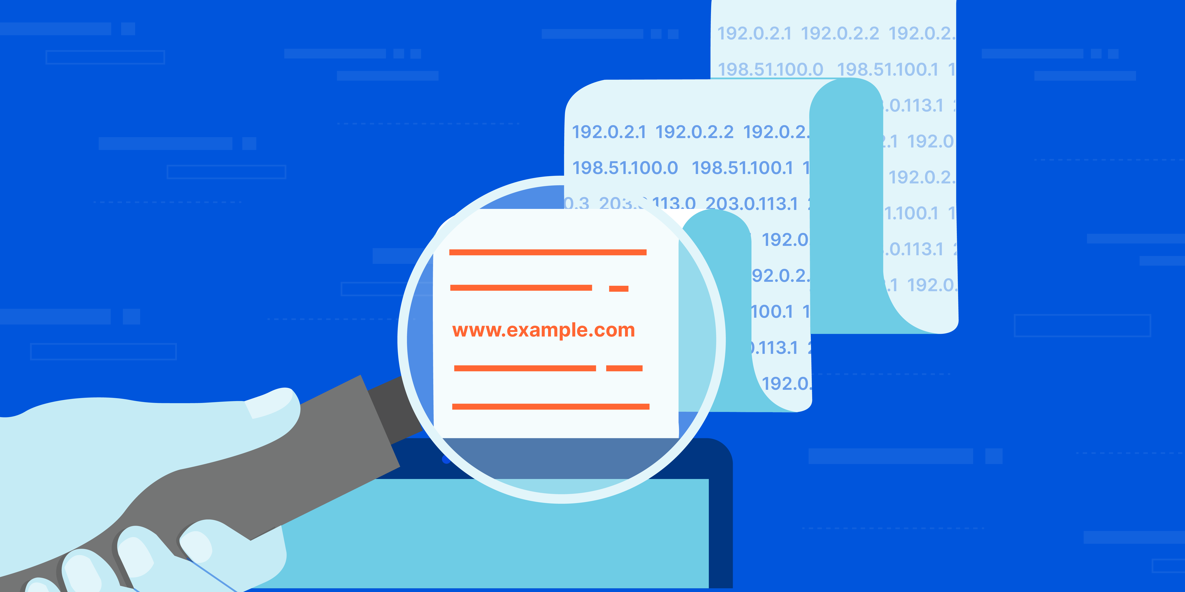
Name and address resolution
Domain name system
The Domain Name System (DNS) is a hierarchical and distributed naming system for resources connected to the Internet, such as computers, services, or any device participating in a network. It serves as a crucial component in translating human-readable domain names into machine-readable IP addresses, facilitating the navigation of the Internet.

Slide 18
Domain name system (DNS)
How it works?
The process of DNS resolution involves converting a hostname (such as www.example.com) into a computer-friendly IP address (such as 192.168.1.1).
An IP address is given to each device on the Internet, and that address is necessary to find the appropriate Internet device - like a street address is used to find a particular home.
When a user wants to load a webpage, a translation must occur between what a user types into their web browser (example.com) and the machine-friendly address necessary to locate the example.com webpage.
In order to understand the process behind the DNS resolution, it’s important to learn about the different hardware components a DNS query must pass between.
For the web browser, the DNS lookup occurs "behind the scenes" and requires no interaction from the user’s computer apart from the initial request.

Slide 19
Domain name system (DNS)
DNS servers involved in loading a webpage
DNS Recursor - The DNS recursor is a server designed to receive queries from client machines through applications such as web browsers. Typically the recursor is then responsible for making additional requests in order to satisfy the client’s DNS query.
Root nameserver - The root server is the first step in translating (resolving) human readable host names into IP addresses. It can be thought of like an index in a library that points to different racks of books - typically it serves as a reference to other more specific locations.

Slide 20
Domain name system (DNS)
DNS servers involved in loading a webpage
TLD nameserver - The top level domain server (TLD) can be thought of as a specific rack of books in a library. This nameserver is the next step in the search for a specific IP address, and it hosts the last portion of a hostname (In example.com, the TLD server is “com”).
Authoritative nameserver - This final nameserver can be thought of as a dictionary on a rack of books, in which a specific name can be translated into its definition. The authoritative nameserver is the last stop in the nameserver query. If the authoritative name server has access to the requested record, it will return the IP address for the requested hostname back to the DNS Recursor (the librarian) that made the initial request.

Slide 21
references
Adam Woodbeck - Network Programming with Go_ Learn to Code Secure and Reliable Network Services from Scratch-No Starch Press (2021).
https://www.cloudflare.com/learning/network-layer/internet-protocol/#:~:text=The%20Internet%20Protocol%20(IP)%20is,protocols%2C%20including%20TCP%20and%20UDP.
https://www.cloudflare.com/learning/security/glossary/what-is-bgp/
https://www.cloudflare.com/learning/dns/what-is-dns/

Slide 22
Thankyou

